Slide 1

Black Panther
Team Members- Ajay , Suraj, Bipin, Smit

Slide 2
Problem Statement
Twitter Sentiment Analyzer in Python:
Objective: Identifying the sentiments about the product/brand .

Slide 3
Why solve this problem? (Business Impact)
Sentiment analysis is contextual mining of text which identifies and extracts subjective information in source material, and helping a business to understand the social sentiment of their brand, product or service while monitoring online conversations

Slide 4
Data points we have.
Target: Sentiment
Tweet
tweet_id

Slide 5
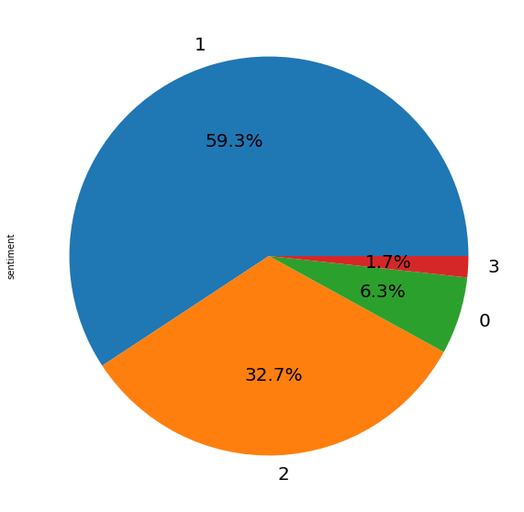
Total no of tweets | 7274
Negative tagged tweets | 456
Neutral tagged tweets | 4311
Positive tagged tweets | 2382
Can’t Tell tagged tweets | 125
[0: Negative, 1: Neutral, 2: Positive, 3: Can't Tell]

Slide 6
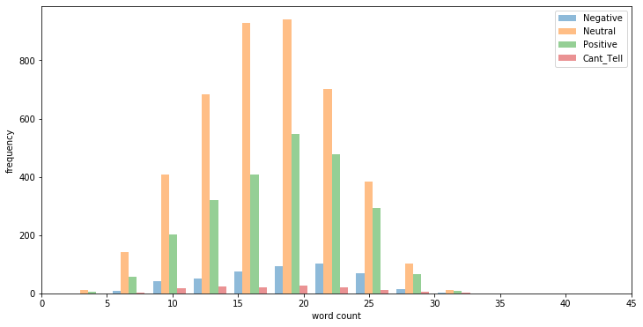
Word Count Frequency Plot

Slide 7
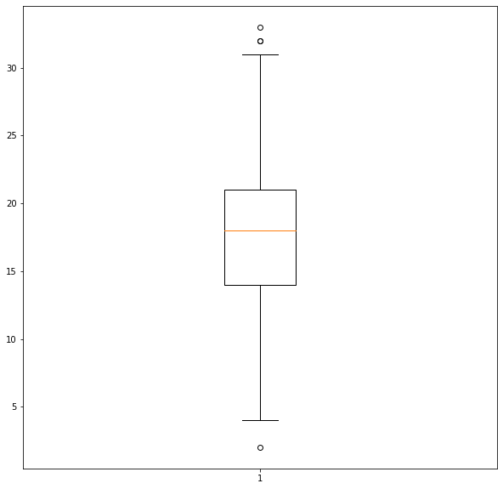
Word Count Box Plot
As per the box plot,
Maximum tweets word counts are between Q1 and Q3
There are very few Outliers which we have removed for our final analysis
2.5 - 30

Slide 8
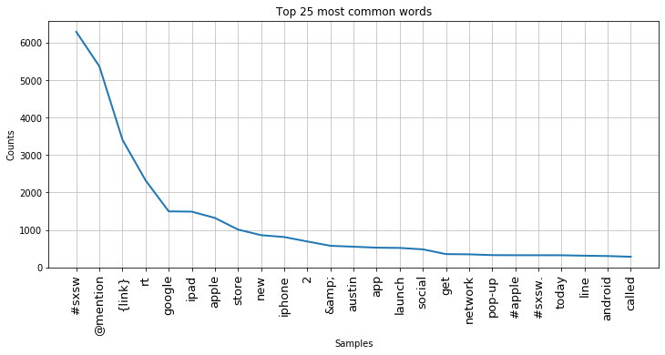
Top 25 common words

Slide 9
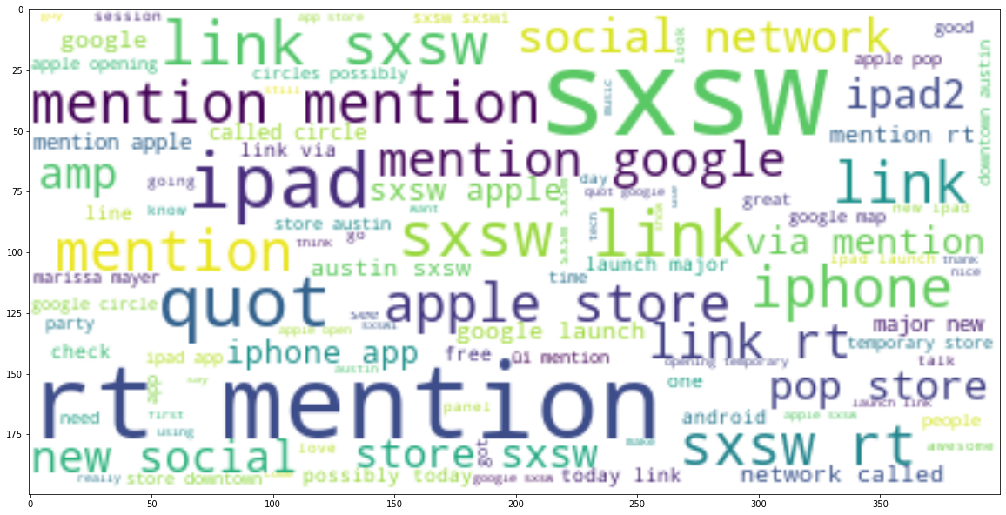
Word Cloud

Slide 10
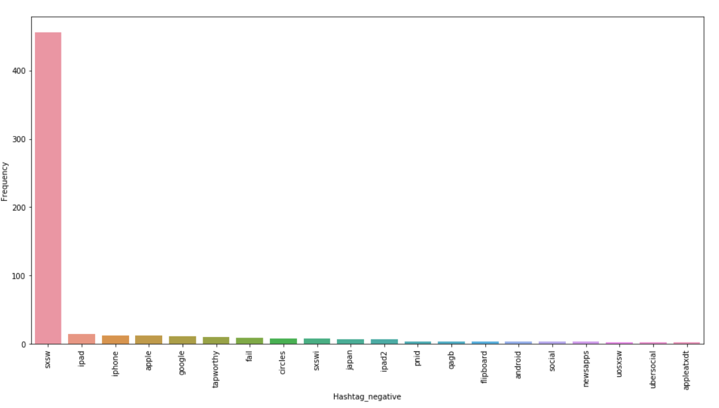
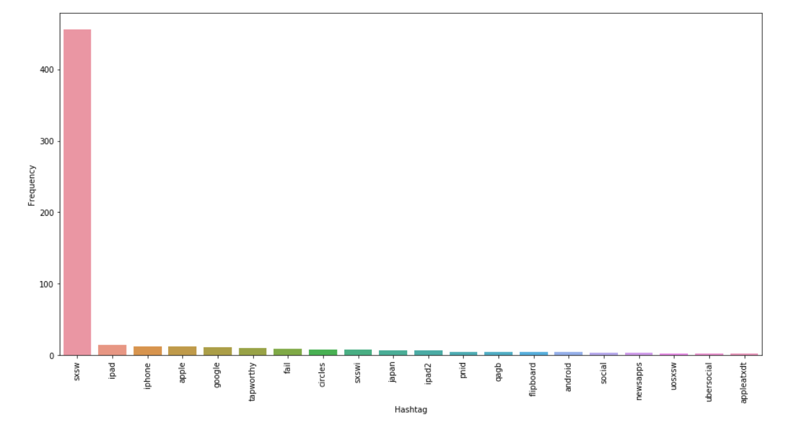
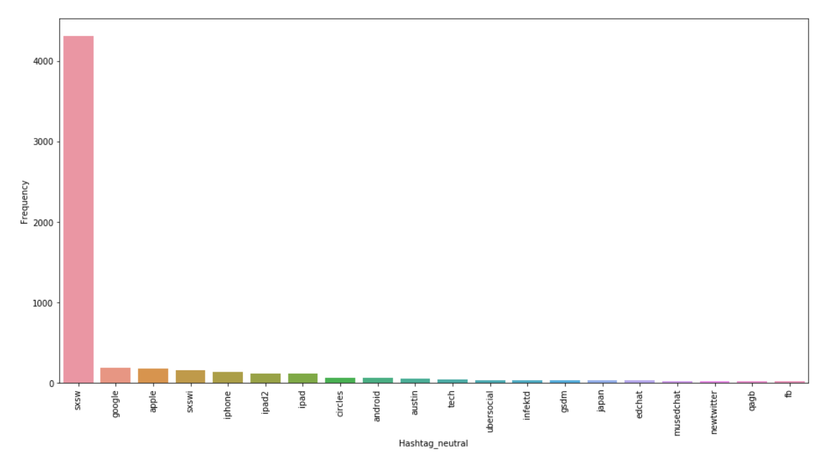
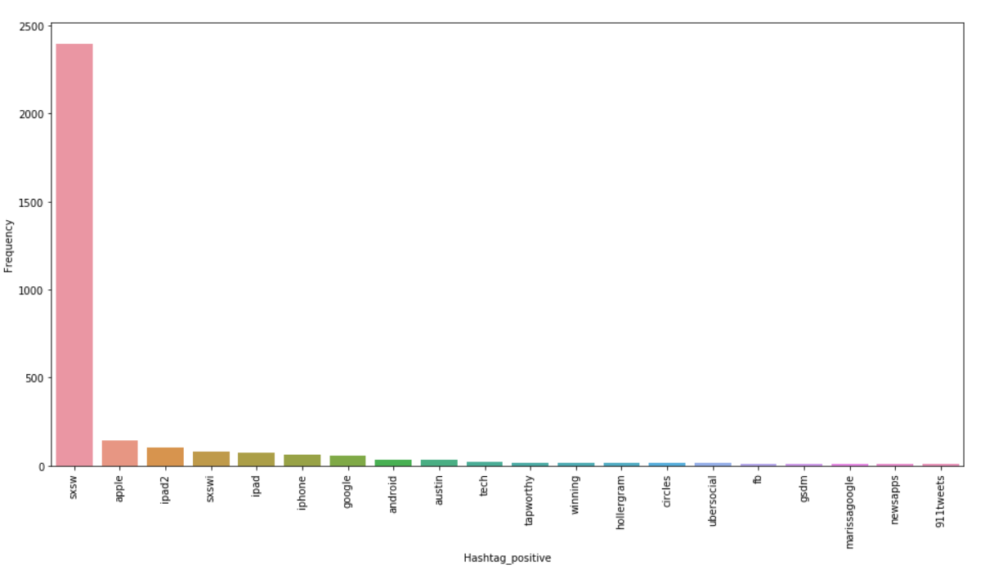
Hashtag Bar Graph

Slide 11
Data Pre Processing
Converted everything to lowercase
Removed Mentions and user handles
Removed Hastags
Removed URL’s
Removed Special characters Numbers and Punctuations
Removed words having length less than 3

Slide 12
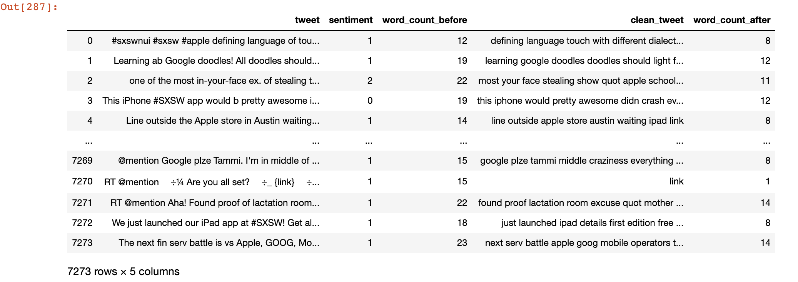
Data Pre Processing Result

Slide 13
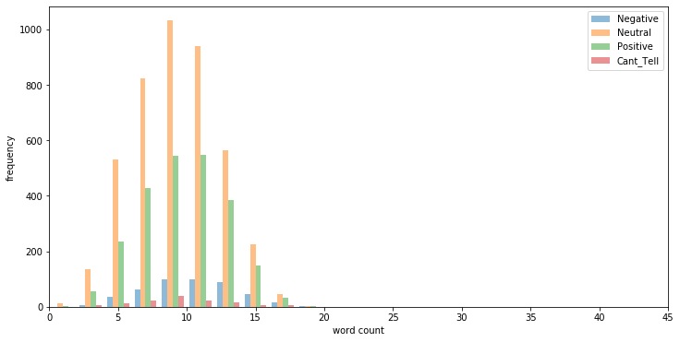
Word Count Frequency Plot

Slide 14
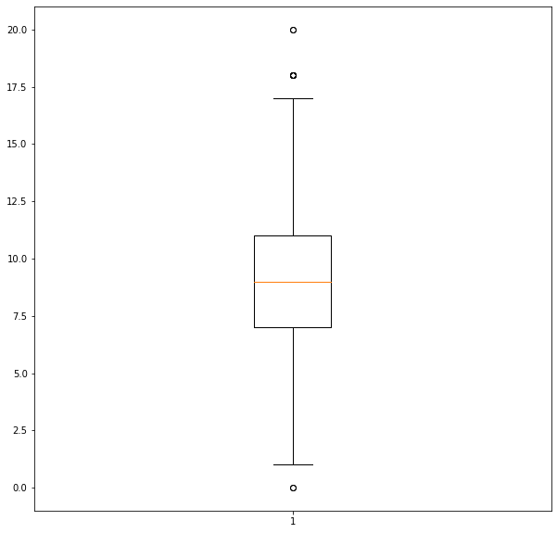
Word Count Box Plot
As per the box plot,
Maximum tweets word counts are between Q1 and Q3
0.5 - 17.5

Slide 15
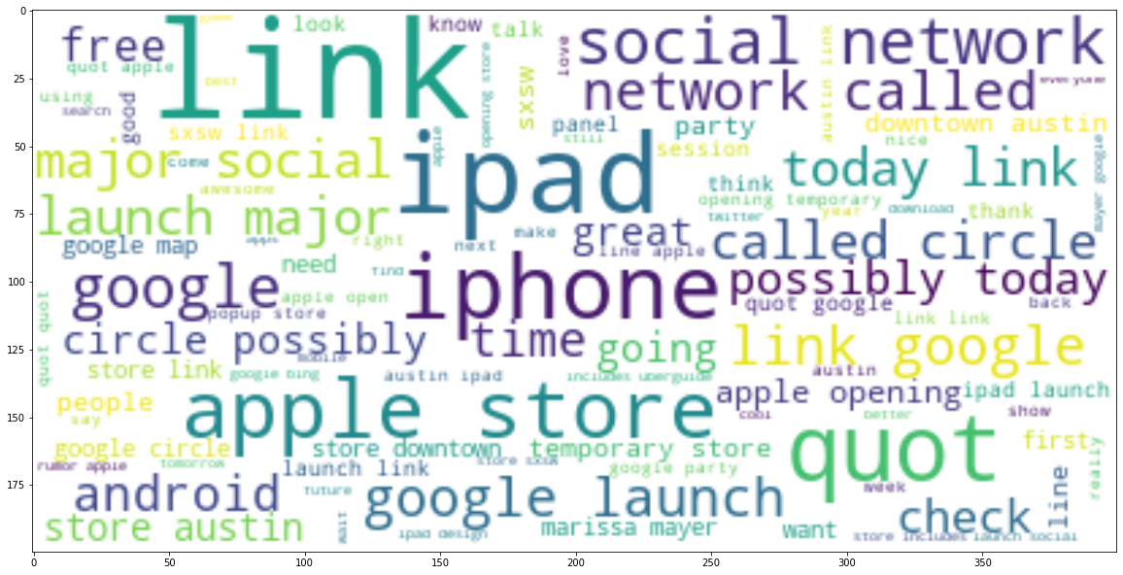
Word Cloud

Slide 16
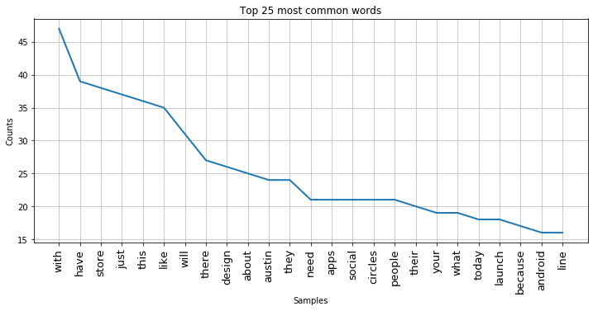
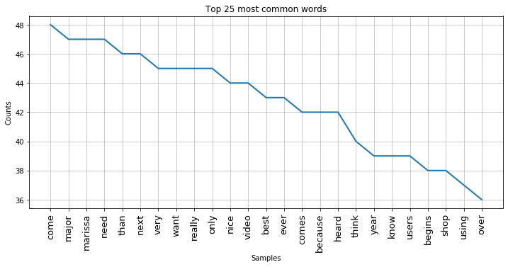
Top 25 words for Negative and Positive Tweets
Negative Words
Positive Words

Slide 17
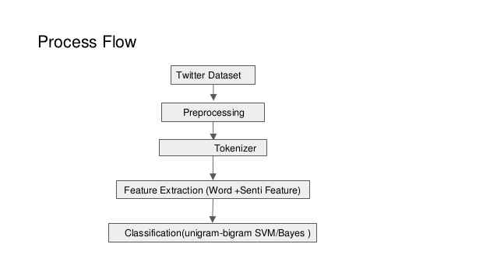
Process Flow

Slide 18
Models and Approaches
Algorithm | Accuracy
Logistic Regression | 0.65
Decision Tree | 0.62
Random Forest | 0.63
XGB | 0.62
Gaussian Naive Bayes | 0.48
Multinomial Naive Bayes | 0.63
Adaboost with Logistic | 0.53

Slide 19
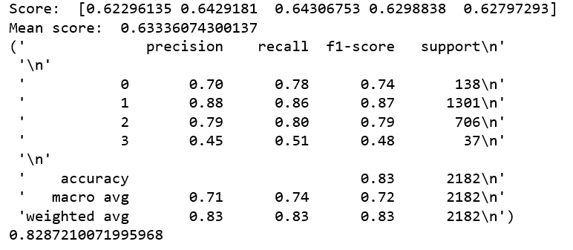
Logistic Regression - Best Model
F1 Score - 0.82
Test Accuracy - 0.68

Slide 20
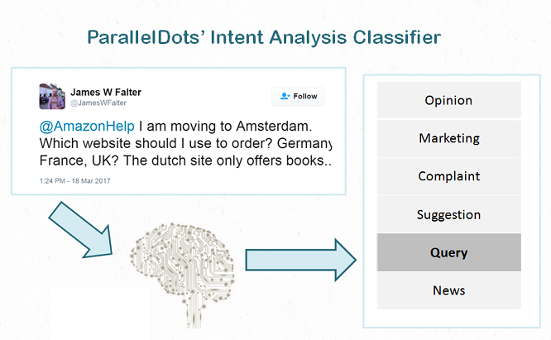
Intent Analysis (Feature Engineering)
Intent Analysis
Intent analysis steps up the game by analyzing the user’s intention behind a message and identifying whether it relates an opinion, news, marketing, complaint, suggestion, appreciation or query.

Slide 21
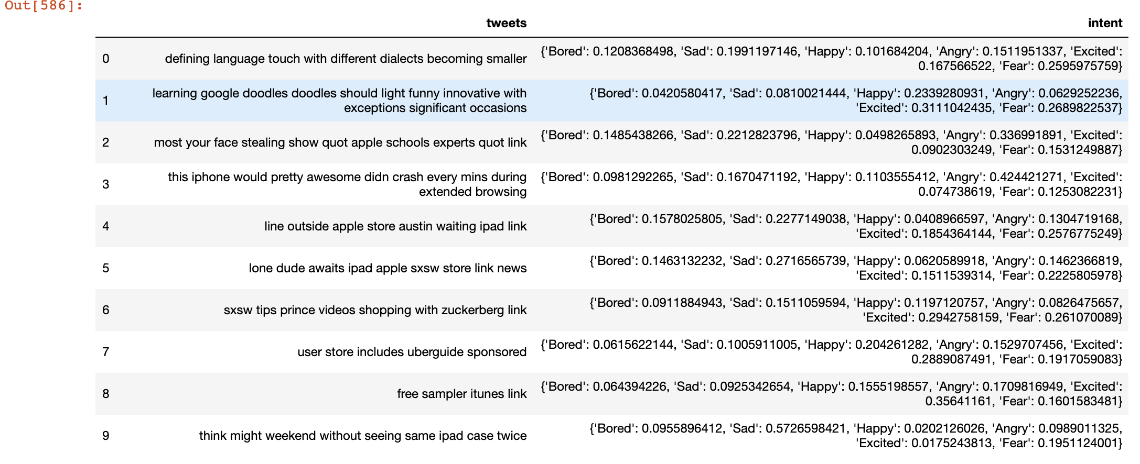
Intent of Tweets

Slide 22
Challenges & Insights
Data is fuzzy
People express opinion in complex ways using acronyms and emoticons
Major use of hashtags and non grammatical words
Out of Vocabulary words
Tweets about Conference talking about Apple and Google Brands

Slide 23
Findings for Business
Twitter is an online social network with over 330 million active monthly users as of February 2018.
Sentiment analysis is contextual mining of text which identifies and extracts subjective information in source material, and helping a business to understand the social sentiment of their brand, product or service while monitoring online conversations

Slide 24
Thank You

